Slide 1
Cloud Architect Nanodegree Program
P3: Secure the Enterprise
Dhruv Kinger
Udacity Mentor| SWE at ThrivePass

Slide 2
Project Walkthrough

Slide 3
Today’s Agenda
Project Summary
Expectations
Rubric Points
Governance in Azure

Slide 4
Project Summary
You are an Azure Cloud Architect for AKMade Enterprises. Your company is a medium-size business with a growing online presence and a desire to utilize the cloud for your IT enterprise. You have been asked to:
Ensure that the current architecture and deployment adhere to security and compliance policies.
Plan with security in mind.
Plan and implement remediation where possible.
Plan user roles according to least privilege.

Slide 5
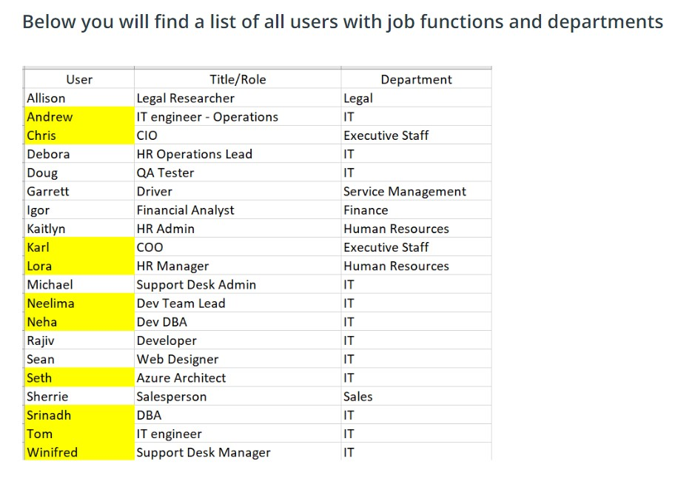

Slide 6
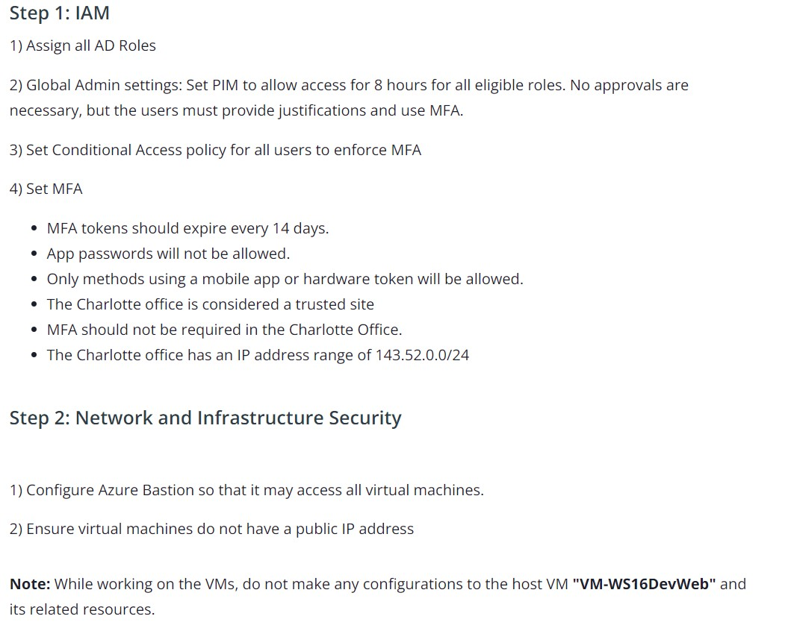
Expectations

Slide 7
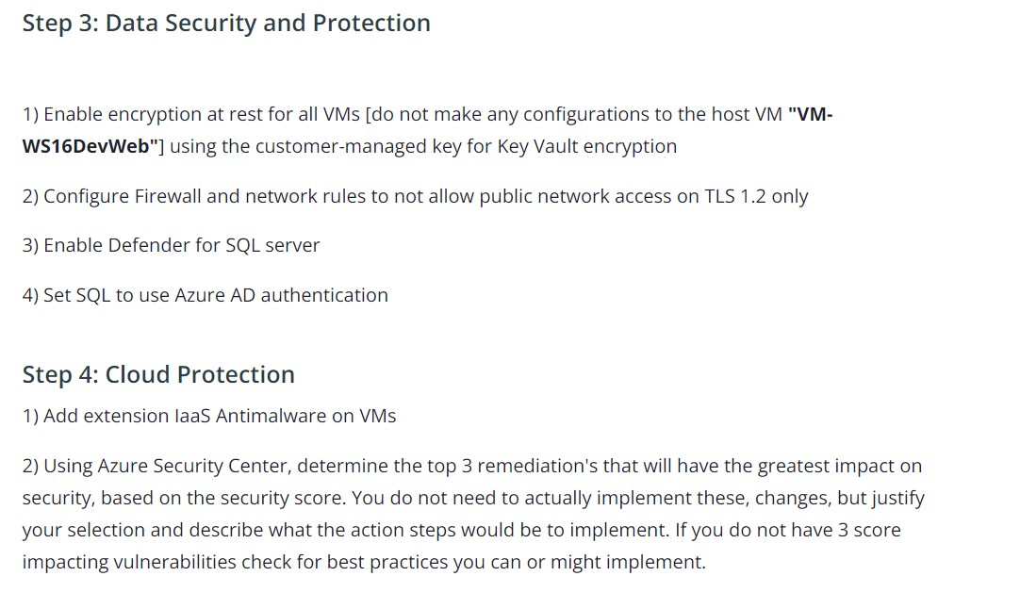
Expectations

Slide 8
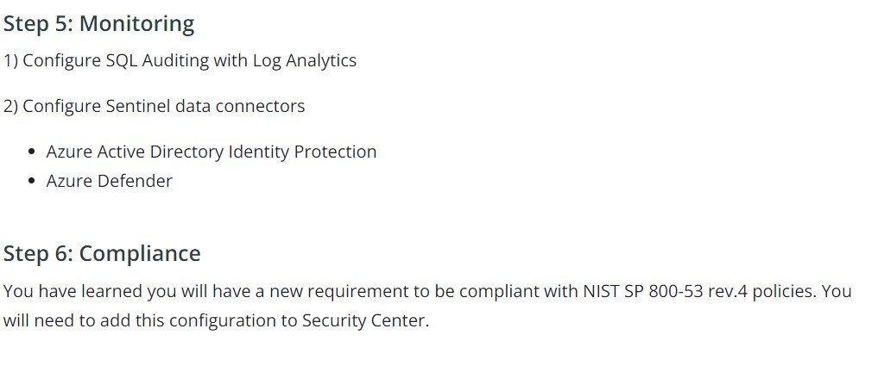
Expectations

Slide 9
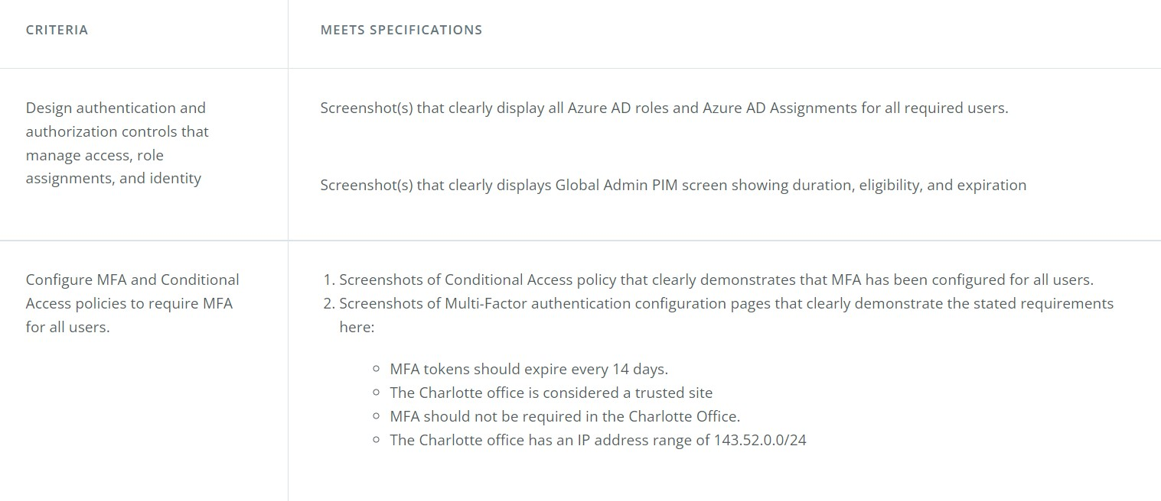
Rubric Points

Slide 10
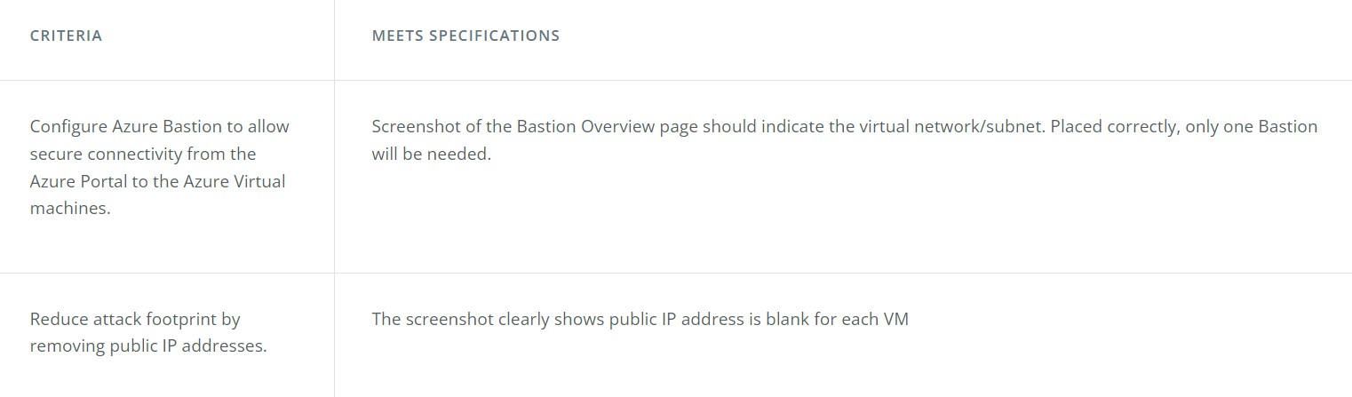
Rubric Points continued

Slide 11
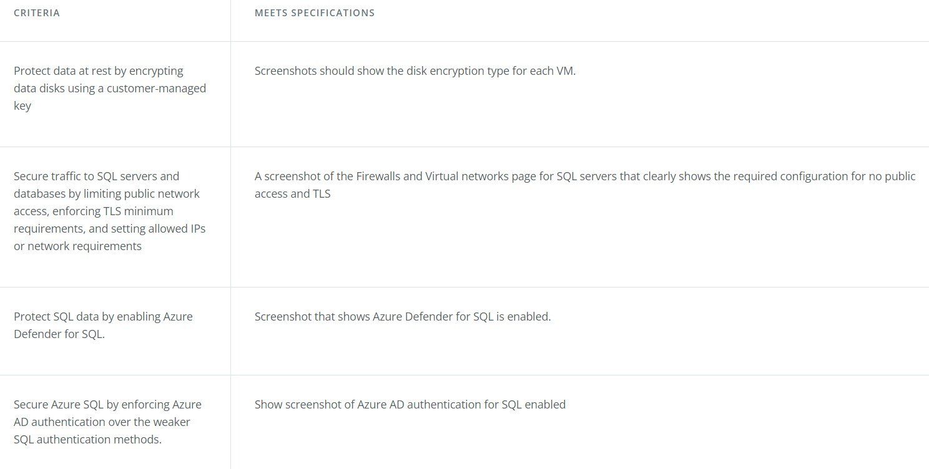
Rubric Points continued

Slide 12
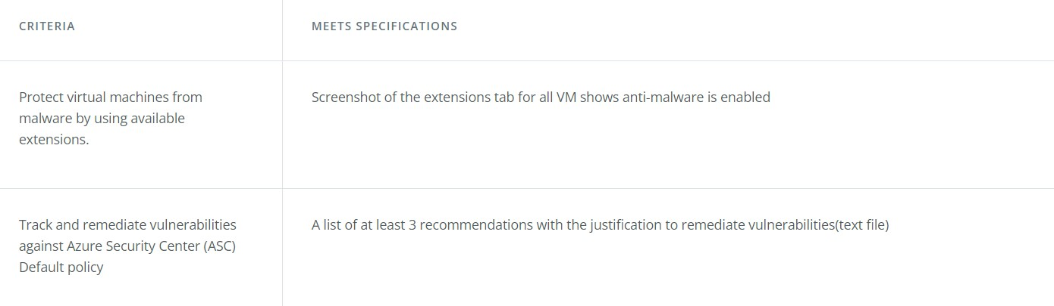
Rubric Points continued

Slide 13
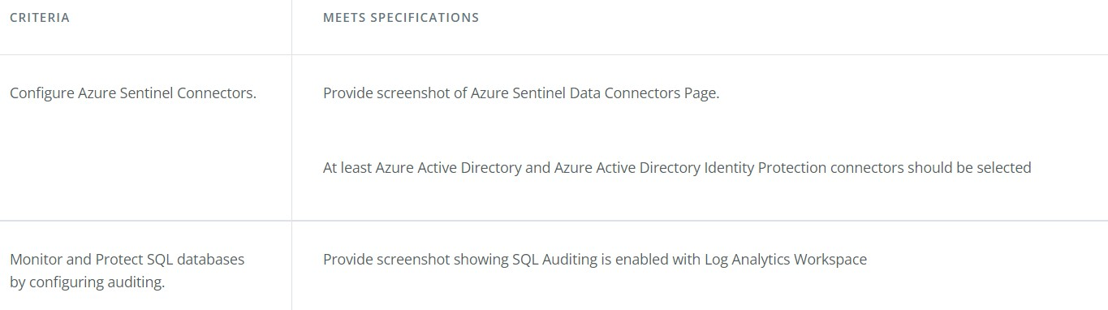
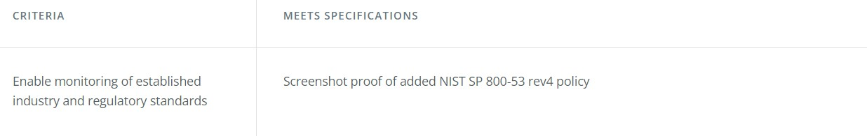
Rubric Points continued

Slide 14
Benefits of Moving to Azure
Data Security : Security in Microsoft Azure is built in at different levels and can be customized as per customer requirements. The security of data stored in Azure is managed by encrypting the data at rest through various mechanisms.
Data Resiliency (elasticity) : When you use Azure cloud storage, your data is physically stored in secure data centers operated by Microsoft. For example, the disks of the virtual machines that you use for your virtual machine are stored as page blobs in Azure storage.
Single-Pane Operations : Last but not the least, it is important to have a single pane of management to gain visibility and insights into what is happening with your infrastructure, & Azure completely fits into this.

Slide 15
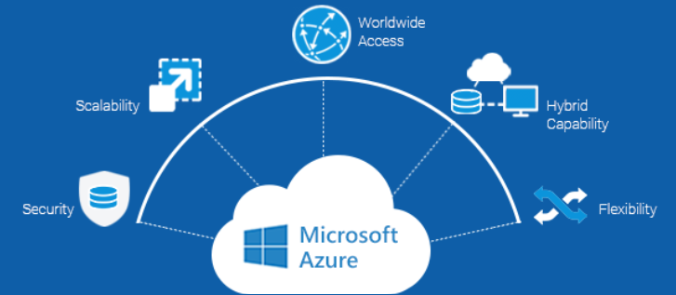
Let’s discuss

Slide 16
Governance in Microsoft Azure
Azure Policy allows you to create, assign, and manage policy definitions to enforce rules for your resources. Azure Policies keeps those resources in compliance with your corporate standards.
Role Based Access Control to manage who can access specific features, resources or implement new technologies.
Tenant and subscription management for deciding on the amount of tenants and subscriptions is something you want to get right from the start. Architecting the right structure for your tenants and subscriptions is a foundation of good governance.
Resource Tagging for organizing resources for cost management, technical management or just to create an overview. Without organising your resources things can become complicated.
Azure Cost Management to track cloud usage and expenditures for your Azure resources and other cloud providers.

Slide 17
Why to implement governance on Azure?
Security & compliance : Customers will demand some form of compliance, trust and security. And if you want to scale your business, you want that too. Through governance, resources can be configured consistently to manage security and compliance risks.
Consistency : In Azure you can choose to deploy a wide variety of technologies, scale your resources as big as you want and deploy them in whichever region you want. The fact that you have those capabilities does not mean you have to provide everyone with the ability to use all of them. In fact, you want to focus on specific technologies and make sure your team deploys them the way that you and your customers expect them to be deployed.
Controlling your costs : Implementing the correct guard rails will make your costs predictable.
Transparency : Controlling who has access to what, what’s running where and who is using it also gives you the possibility to be transparent to your customers.

Slide 18
Additional Resources
How to Setup a Azure Budgets ?
Want to read some of mine Azure Related Blogs ?
Thinking to get Microsoft Certified ? Here are some of the Paths.
Want to optimize your cloud spending ? Do give a Read.
Want a Free Voucher for Microsoft Certification Exam ? Do give a Read.

Slide 19
🙏 Thanks 🙏
Want to Connect ?
Twitter Handle: @KingerDhruv
LinkedIn: https://linkedin.com/in/dhruv-kinger
GitHub: https://github.com/DhruvKinger

